Slide 1
Domain: DL
Technology: Python
Stock Price Prediction using Machine Learning

Slide 2
INDEX
Project Description
Problem Statement
Objective
Scope
Literature Survey
Significant
Proposed System
Architecture
Resource Requirements
Research Gap analysis
Implementation
Implementation
1. Data Description
2. EDA
3. Preprocessing steps
Model Implementation
1. Algorithm Definition
2. Working Flow
References

Slide 3
Project Description
This project aims to develop reliable models for predicting stock prices, focusing on banking sector stocks from the Nifty 50 index, including SBI, HDFC, Axis, ICICI, and IndusInd Bank. By analyzing five years of market data, the project compares traditional and advanced techniques such as Vanilla LSTM, Stacked LSTM, GRU, RNN. The objective is to forecast stock closing prices for the first half of 2024 and validate model accuracy by comparing predictions with actual data. The project seeks to create an optimal forecasting model that aids investors, analysts, and financial professionals in making informed decisions. This helps reduce risks and optimize investment strategies, demonstrating the potential of advanced data analysis in financial forecasting.

Slide 4
Problem Statement
The stock market is inherently volatile, making it challenging for investors and financial professionals to predict stock prices accurately. Traditional forecasting methods often fall short in capturing the complex patterns and behaviors of stock market data. This project aims to address this challenge by developing an optimal and reliable forecasting model using both traditional and advanced machine learning techniques (Vanilla LSTM, Stacked LSTM, GRU, RNN) to predict the stock prices of five prominent banks in the Nifty 50 index: SBI, HDFC, Axis, ICICI, and IndusInd Bank. The goal is to enhance decision-making in the financial sector by providing precise stock price predictions, reducing investment risks, and contributing to the advancement of financial forecasting methodologies.

Slide 5
Objective of the Project
This study investigates evaluating deep learning techniques to enhance stock price forecasting accuracy.
• Data Collection and Analysis: Historical stock price data for five major Indian banks SBI, HDFC, AXIS, ICICI, and IndusInd Bank—will be gathered over the past five years using the Yahoo Finance API. Exploratory Data Analysis (EDA) will identify trends and patterns.
• Feature Engineering: The study will implement feature engineering to improve data quality, preparing it for machine learning models by transforming and selecting relevant features.
• Model Development: Various models, including Vanilla LSTM, Stacked LSTM, GRU, RNN, will be built and trained to predict future stock prices.
• Model Evaluation: Trained models will be tested with 2024 data, using metrics like MSE, MAE, RMSE, and R² Score to assess performance.

Slide 6
Scope
Development of Advanced Forecasting Models: The project will explore and compare traditional and advanced techniques, including Vanilla LSTM, Stacked LSTM, GRU, RNN, , and , to predict stock prices with a focus on five major banks from the Nifty 50 index.
Real-World Application in Financial Markets: By providing accurate stock price predictions for SBI, HDFC, Axis, ICICI, and IndusInd Bank, the project aims to assist investors and financial professionals in making informed investment decisions, minimizing risks, and optimizing strategies.
Validation and Contribution to Financial Forecasting: The project will validate model predictions against actual market data for the first half of 2024, contributing to the broader field of financial forecasting by demonstrating the effectiveness of advanced data analysis in predicting stock market behavior.

Slide 7
LITERATURE SURVEY
Author | Year | Title | Outcomes
Diaa Salama Abd Elminaam, et al. | 2024 | StockBiLSTM: Utilizing an Efficient Deep Learning Approach for Forecasting Stock Market Time Series Data | Introduced StockBiLSTM for efficient stock market forecasting, improving prediction accuracy.
Kumar, R., Kumar, P., Kumar Y. | 2021 | Analysis of Financial Time Series Forecasting using Deep Learning Model | Demonstrated the use of deep learning models to analyze and forecast financial time series data.

Slide 8
LITERATURE SURVEY
Author | Year | Title | Outcomes
Zhang, K., Zhang G., Dong, J. | 2019 | Stock Market Prediction Based on Generative Adversarial Network | effectively models stock market behaviors and enhances prediction accuracy.
Fischer, T., & Krauss, C. | 2018 | Deep Learning with Long Short-Term Memory Networks for Financial Market Predictions | LSTM networks significantly improve financial market predictions compared to traditional methods.

Slide 9
Significant
Improved Predictive Accuracy: The project leverages a range of traditional and advanced models to identify the best method for forecasting banking stock prices, enhancing prediction reliability.
Support for Informed Decision-Making: Accurate stock price predictions help investors and financial professionals reduce risks and optimize investment strategies.
Understanding Market Behavior: Analyzing historical data uncovers trends in stock movements, aiding in better anticipation of market shifts.
Advancing Financial Forecasting: The project highlights the potential of advanced AI and machine learning models in improving stock market predictions.

Slide 10
Proposed System:
The proposed system aims to develop a robust stock price prediction model by utilizing a variety of machine learning techniques, including Vanilla LSTM, Stacked LSTM, GRU, RNN and It focuses on forecasting the stock prices of five prominent banking institutions from the Nifty 50 index—SBI, HDFC, Axis, ICICI, and IndusInd Bank—using five years of historical market data. The system will generate predictions for the first half of 2024 and compare them with actual stock prices to validate model accuracy. The ultimate goal is to create a reliable model that supports better financial decision-making and investment strategies.

Slide 11
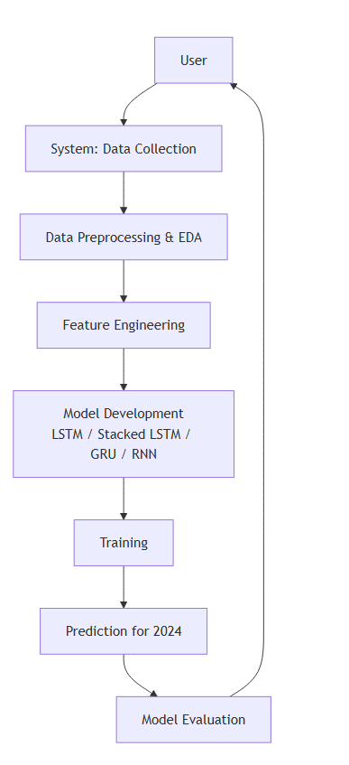
Architecture

Slide 12
Resource Requirements
01
Hardware
(Processor: I5/Intel Processor, RAM: 8GB (min), Hard Disk: 128 GB, Key Board: Standard Windows Keyboard, Mouse: Two or Three Button Mouse)
Resources
02
Software
(Operating System: Windows 10, Programming Language: Python 3.10.8, IDE: Colab)
03
Packages/Libraries
(Pandas, Numpy, Scikit-learn, Yahoo Finance(yfinance), tensorflow, keras)

Slide 13
Research Gap analysis
Limited Use of Advanced Models: While traditional models like RNNs are often used in stock price prediction, the application of more advanced models such as s and s remains underexplored in this domain, especially for banking stocks.
Sector-Specific Forecasting: Most existing studies focus on broad stock indices or general sectors. There is a gap in focused research on predicting stock prices for the banking sector, particularly in the context of Indian banks listed under Nifty 50.
Short-Term Prediction Accuracy: Many models struggle with short-term prediction accuracy due to the volatile nature of the stock market, indicating the need for more refined techniques and comparative studies to enhance performance.

Slide 14
Implementation
Data Analysis
Model Implementation
01
Data Description
03
Algorithm Definition
02
Working Process
04
Preprocessing steps
05
Results from Algorithm

Slide 15
Data Description
Stock Data Source: The dataset includes historical stock data from five major Indian banks (SBI, HDFC, Axis, ICICI, and IndusInd) listed on NSE, collected via Yahoo Finance API from January 1, 2019, to June 30, 2024.
Focus on Closing Prices: The dataset centers on the closing price of each stock, an essential indicator used in financial performance measurement, technical analysis, and stock price prediction.
Chronological Analysis: Each entry is timestamped with the trading date, allowing for the examination of trends, patterns, and stock performance over time.
Predictive Modeling Input: The dataset is designed for time-series forecasting and machine learning analysis, providing a streamlined, focused approach for stock price prediction.

Slide 16
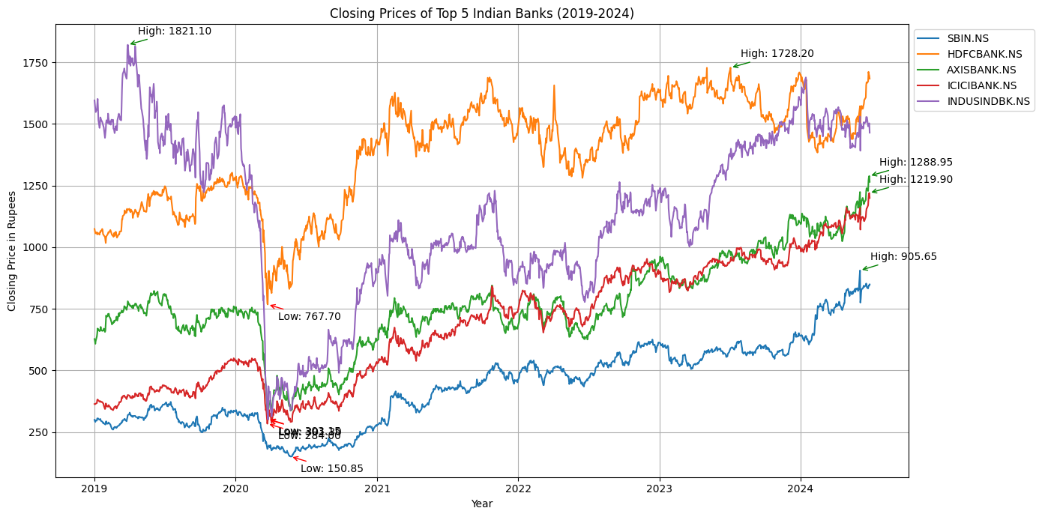
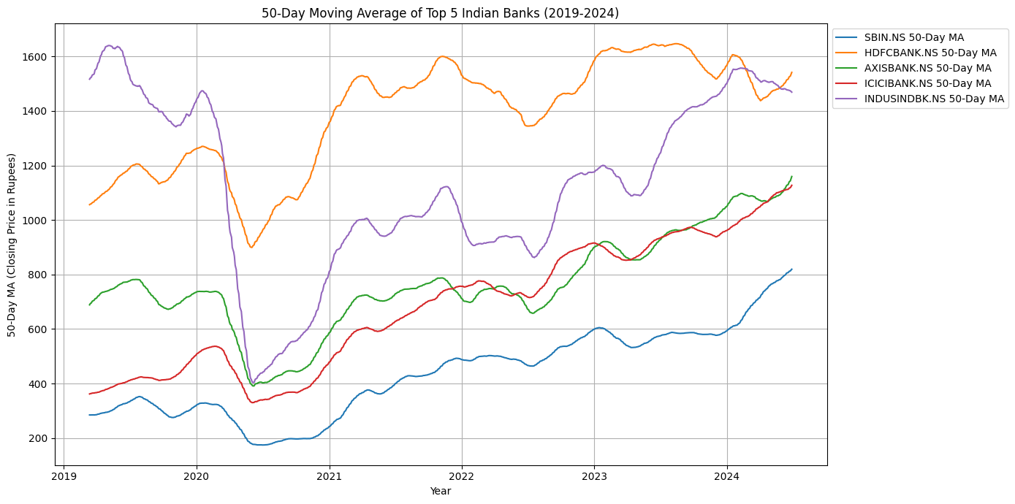
EDA
The graph shows the closing prices of top 5 Indian banks from 2019 to 2024, highlighting a sharp decline in early 2020 due to the COVID-19 pandemic, followed by a recovery trend. ICICI and IndusInd Bank display the most volatility and growth, while HDFC Bank shows a steady upward trend, with stock prices stabilizing by 2024.
The graph shows the 50-day moving averages of SBI, HDFC Bank, Axis Bank, ICICI Bank, and IndusInd Bank from 2019 to 2024. After a dip in early 2020 due to COVID-19, all banks show recovery, with ICICI Bank leading in performance, IndusInd Bank displaying volatility, and HDFC Bank maintaining steady growth. By 2024, all banks exhibit stable upward trends, reflecting sector growth.

Slide 17
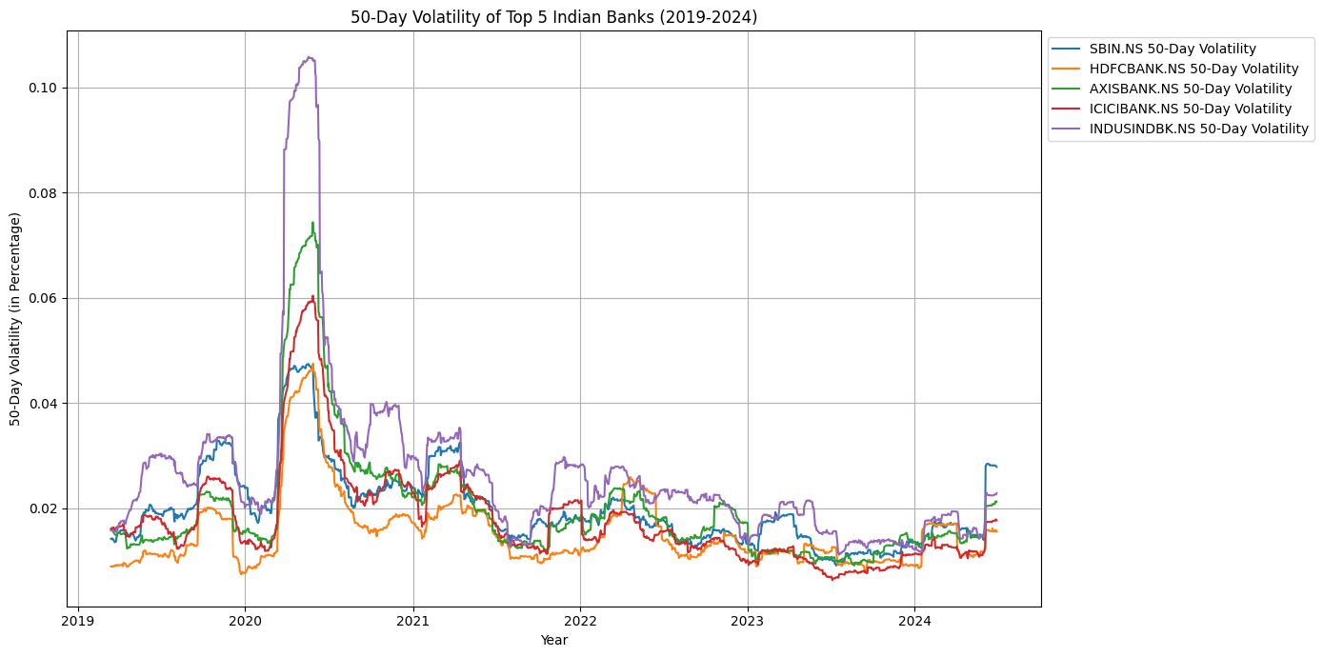
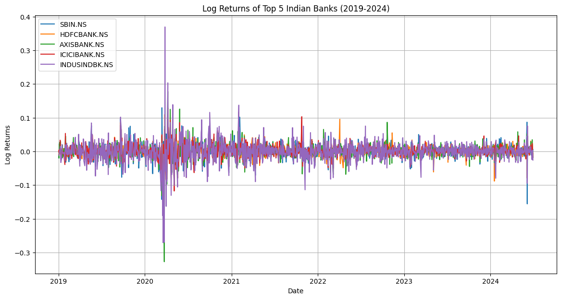
EDA
The graph shows the 50-day volatility of SBI, HDFC, Axis, ICICI, and IndusInd Bank from 2019 to 2024. A spike in early 2020 due to COVID-19 was followed by a steady decrease, stabilizing by mid-2021. A slight uptick in volatility is seen toward the end, particularly in SBI.
The graph shows the log returns of SBI, HDFC Bank, Axis Bank, ICICI Bank, and IndusInd Bank from 2019 to 2024, highlighting significant volatility in early 2020 due to COVID-19, especially for IndusInd Bank. Post-2020, log returns stabilize, indicating more consistent performance across all banks.

Slide 18
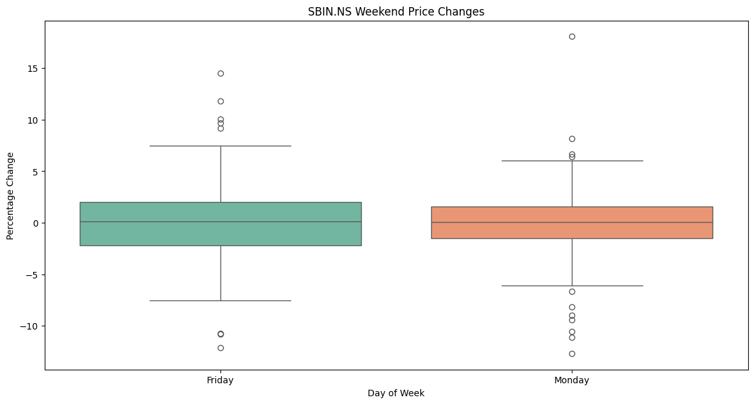
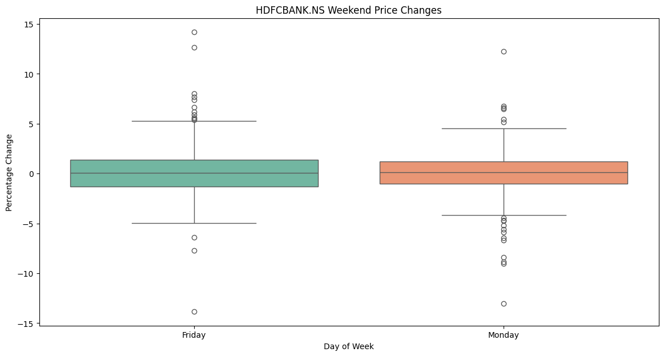
EDA
The box plot compares the percentage price changes of SBIN.NS on Fridays and Mondays. Fridays show generally positive price changes with fewer outliers, indicating stability, while Mondays exhibit greater variability and extreme outliers, suggesting unpredictable movements after the weekend.
The box plot compares the percentage price changes of HDFCBANK.NS on Fridays and Mondays, illustrating the weekend effect. Fridays show generally positive price changes with some outliers, while Mondays exhibit greater volatility and more extreme outliers. Both days have a positive median, but Mondays are more unpredictable, likely due to weekend market reactions..

Slide 19
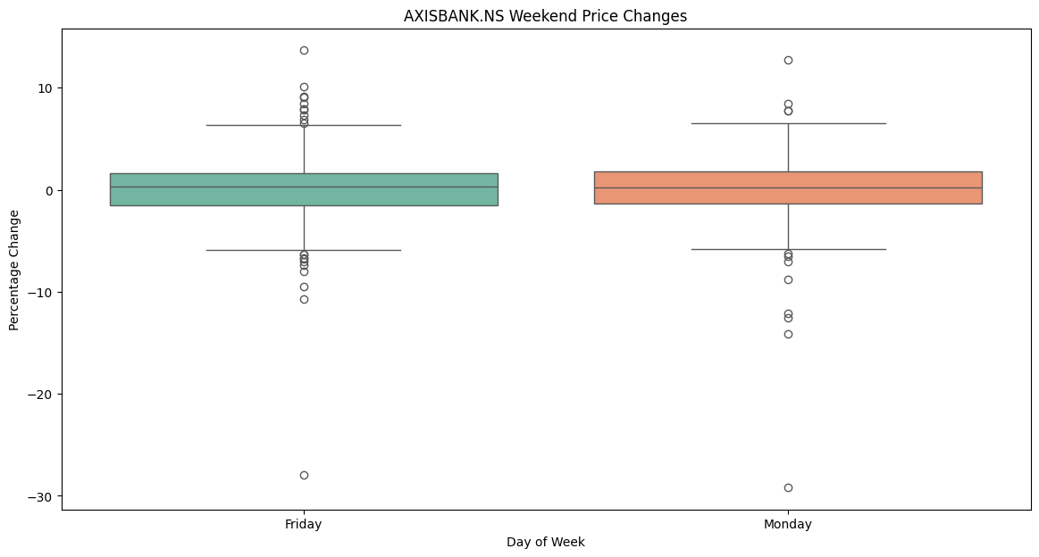
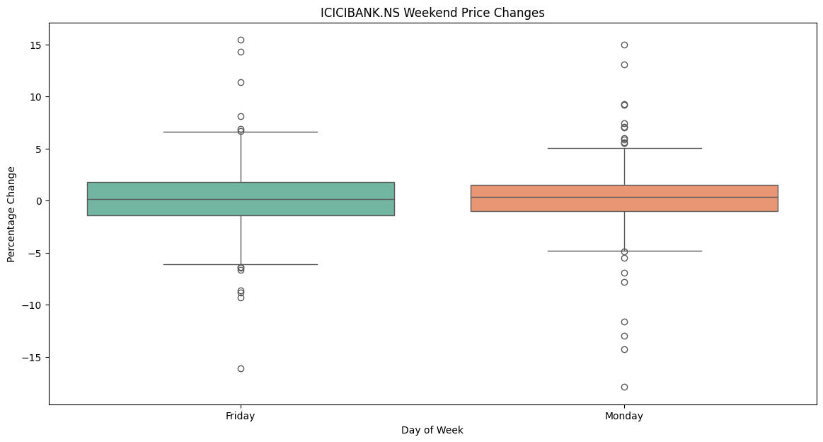
EDA
The box plot reveals that AXISBANK.NS experiences greater volatility and more extreme price changes, especially negative, on Mondays compared to Fridays. Fridays show relatively more stability, with fewer extreme movements.
The box plot shows that ICICIBANK.NS experiences greater volatility and more extreme positive price changes on Mondays compared to Fridays. Fridays exhibit more stable price movements with fewer extremes, indicating lower volatility before the weekend.

Slide 20
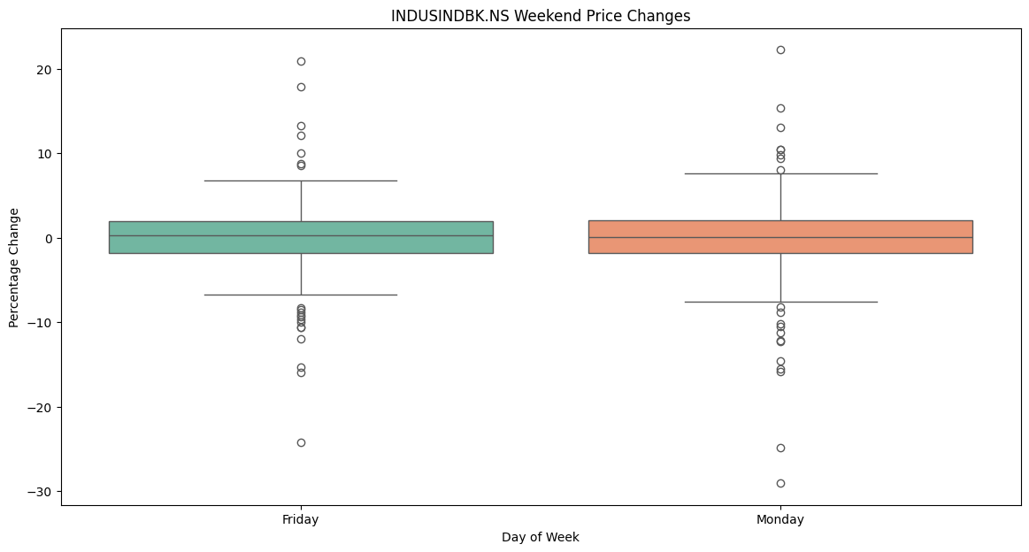
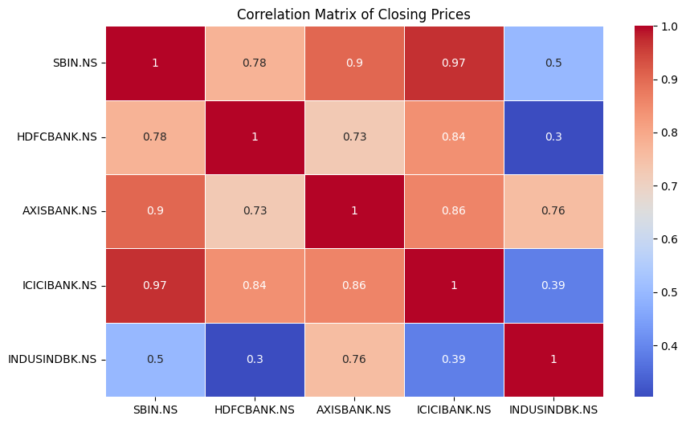
EDA
The box plot reveals that INDUSINDBK.NS experiences greater volatility and more extreme positive price changes on Mondays compared to Fridays. Fridays show more stable price movements, indicating a calmer trading environment before the weekend.
The heatmap shows strong positive correlations between SBIN.NS and ICICIBANK.NS (0.97), and SBIN.NS and AXISBANK.NS (0.9), indicating similar price movements. INDUSINDBK.NS has weaker correlations with other banks, particularly with HDFCBANK.NS (0.3) and ICICIBANK.NS (0.39), reflecting less synchronized price movements.

Slide 21
Pre-processing steps
Data Normalization: Min-Max scaling is used to bring features like stock prices and trading volumes into a uniform range, typically between 0 and 1. This prevents larger numerical features from dominating the model and aids in faster convergence during model training, especially for gradient-based algorithms.
Data Splitting: In time series forecasting, data is split sequentially into training and testing sets, preserving chronological order. This avoids data leakage and ensures that the model is evaluated on the most recent data, simulating real-world forecasting scenarios.
Rolling Window Approach: This method uses a fixed window of historical data to continuously update the model, allowing it to predict the next time step. The window shifts forward after each prediction, helping the model adapt to recent market trends for improved stock price forecasting.
Data Cleaning: This process involves handling missing values through techniques like forward filling and interpolation, managing outliers using methods like Z-score analysis or interquartile range, and performing consistency checks to ensure data accuracy and reliability for better model performance.

Slide 22
ALGORITHMS
Vanilla LSTM
Vanilla LSTM Model Overview: The Vanilla LSTM model is used to predict stock prices for five major Indian banks listed in the Nifty50 index. It is designed to capture long-term patterns in time series data and serves as a benchmark for comparing more advanced models like Stacked LSTM and GRU.
Model Architecture: The architecture includes a bidirectional LSTM layer, followed by dropout layers to prevent overfitting, a second unidirectional LSTM layer, and a Dense layer for merging outputs. The final output is a single-unit Dense layer that predicts the stock price.
Compilation and Optimization: The model uses the Adam optimizer with a learning rate between 1e-4 and 1e-2 and the Mean Squared Error (MSE) loss function, making it suitable for stock price prediction tasks. Hyperparameters such as LSTM units, dropout rates, and learning rates are fine-tuned to optimize performance.
Model Training and Evaluation: The model is trained on historical stock data (closing prices and trading volumes) from five banks, with the data split into training and validation sets. The results from the Vanilla LSTM serve as a baseline for evaluating more complex models like Stacked LSTM and GRU.

Slide 23
ALGORITHMS
Stacked LSTM
Stacked LSTM Model Overview: The Stacked LSTM model enhances the Vanilla LSTM by incorporating multiple LSTM layers, making it more capable of capturing complex temporal relationships in stock price data. It is used to predict the prices of five major Indian banks in the Nifty50 index.
Model Architecture: The architecture includes 2 to 4 LSTM layers with units ranging from 50 to 200. Dropout layers are applied after each LSTM layer to prevent overfitting, and a Dense layer processes the output before predicting the stock price.
Compilation and Optimization: The model is compiled using the Adam optimizer with a learning rate between 1e-4 and 1e-2, and Mean Squared Error (MSE) is used as the loss function to penalize prediction errors.
Training and Evaluation: The model is trained on normalized historical stock price data, with the dataset split into training and validation sets. The Stacked LSTM's performance is compared to Vanilla LSTM and GRU models, with expectations of better handling complex financial time series patterns.

Slide 24
ALGORITHMS
RNN
RNN Layers: The model uses 1–3 RNN layers with 50–200 units per layer, capturing temporal dependencies. The return_sequences parameter is enabled for all layers except the last, which outputs the final state.
Dropout and Dense Layers: Dropout layers (0.1–0.5) reduce overfitting after each RNN layer, while Dense layers (10–50 units) combine features and output the final stock price prediction.
Compilation: The model uses the Adam optimizer (learning rate 1e-4 to 1e-2) and MSE as the loss function to minimize prediction errors in stock prices.
Training and Tuning: Hyperparameter optimization adjusts layers, units, dropout rates, and learning rates. The model’s performance is compared with GRU and LSTM, prioritizing faster training for real-time forecasting.

Slide 25
ALGORITHMS
GRU
GRU Layers: The model uses 2–4 GRU layers with 50–200 units per layer, capturing temporal dependencies in stock data, with return sequences enabled for all but the final layer.
Dropout and Dense Layers: Dropout (0.1–0.5) prevents overfitting after each GRU layer, followed by Dense layers to reduce dimensions and output the predicted stock price.
Compilation: The model is compiled using the Adam optimizer (learning rate 1e-4 to 1e-2) with MSE loss for accurate regression predictions.
Hyperparameter Tuning: Systematic tuning of layers, units, dropout rates, and learning rates is done, comparing GRU performance with Vanilla and Stacked LSTM models.

Slide 26
Working Flow of Stacked LSTM
Input Sequence Processing: In a Stacked LSTM, sequential input data (e.g., stock prices) is fed into multiple layers of LSTM cells. The output from one LSTM layer serves as the input for the next, enabling deeper learning of temporal patterns.
Multiple LSTM Layers: Each LSTM layer processes the sequence, capturing more complex temporal dependencies at different levels. The return_sequences parameter is typically set to True for all layers except the final one to pass the full sequence between layers.
Final LSTM Layer: The last LSTM layer outputs either the final hidden state or the entire sequence, depending on the configuration, which represents the learned features of the input data.
Dense Layer for Prediction: The output of the final LSTM layer is fed into a Dense layer to generate the final prediction, such as the next stock price in the sequence. This stacking increases model capacity for learning more intricate patterns.

Slide 27
Working Flow of RNN
Input Sequence Processing: The RNN model processes sequential input data (e.g., stock prices) one time step at a time, passing the current input and previous hidden state to the RNN cell, which captures short-term temporal dependencies.
RNN Cell Mechanism: At each time step, the RNN cell updates its hidden state using the current input and the previous hidden state. The RNN lacks the advanced gating mechanisms of LSTM, making it more prone to vanishing gradients when processing long sequences.
Hidden State Propagation: The hidden state is propagated through each time step of the sequence, learning dependencies based on the input data. However, RNNs can struggle to capture long-term dependencies compared to LSTM or GRU models.
Dense Layer for Output: After the final time step, the hidden state is passed to a Dense layer, which produces the final prediction (e.g., stock price prediction for the next time step). The simplicity of RNNs makes them faster but less effective for long sequences.

Slide 28
Working Flow of GRU
Input Sequence Processing: GRU processes sequential input data (e.g., stock prices) by passing the input and the previous hidden state into its gated units, effectively capturing temporal dependencies across time steps.
GRU Cell Mechanism: Each GRU cell uses two gates—update gate and reset gate—to control the flow of information. The update gate decides how much of the past information to retain, while the reset gate controls how much of the past data to forget.
Hidden State Propagation: The GRU updates the hidden state at each time step based on the gates' outputs, allowing it to efficiently capture both short-term and long-term dependencies in the sequence, without separate memory cells like in LSTM.
Final Prediction: After processing the sequence, the final hidden state is passed to a Dense layer, which generates the prediction (e.g., stock price). GRUs offer a simpler, faster alternative to LSTMs while maintaining strong performance in capturing sequence patterns.

Slide 29
References
Fischer, T., & Krauss, C. (2018). Deep Learning with Long Short-Term Memory Networks for Financial Market Predictions. European Journal of Operational Research, 270(2), 654-664. doi:10.1016/j.ejor.2017.11.054
Hochreiter, S., & Schmidhuber, J. (1997). Long Short-Term Memory. Neural Computation, 9(8), 1735-1780. doi:10.1162/neco.1997.9.8.1735
Zhang, K., Zhang G., Dong, J., (2019). Stock Market Prediction Based on Generative Adversarial Network. Procedia Computer Science, 147, 400-406. doi:10.1016/j.procs.2019.01.256
Kumar, R., Kumar, P., Kumar Y., (2021). Analysis of Financial Time Series Forecasting using Deep Learning Model. 2021 11th International Conference on Cloud Computing, Data Science & Engineering. doi:10.1109/Confluence51648.2021.9377158
Diaa Salama Abd Elminaam, Asmaa M M. El-Tanany, Mohamed Abd El Fattah and Mustafa Abdul Salam, (2024). StockBiLSTM: Utilizing an Efficient Deep Learning Approach for Forecasting Stock Market Time Series Data. International Journal of Advanced Computer Science and Applications (IJACSA), 15(4), doi:10.14569/IJACSA.2024.0150446

Slide 30
THANK YOU

